Slide 1
Time Series - Laboratory

Slide 2


MySelf:
Actuary during the day &
AI Scientist in the free time
Reach Me:
MyLinks

Slide 3

Program
Stock Market Forecasting with Conformal Prediction and Stock Analysis with AI Agent Recommendations
US Injuries Flood Prediction with Large Language Models Data Augmentation
Sequence Sentiment Classification with Large Language Models
Assignment

Slide 4

Stock Market Forecasting with Conformal Prediction and Stock Analysis with AI Agent Recommendations

Slide 5

Motivations
Build a Predictive AI use case
Experiment Conformal Prediction with stocks
Try to merge Predictive AI with the power of Generative AI
Google Banana

Slide 6
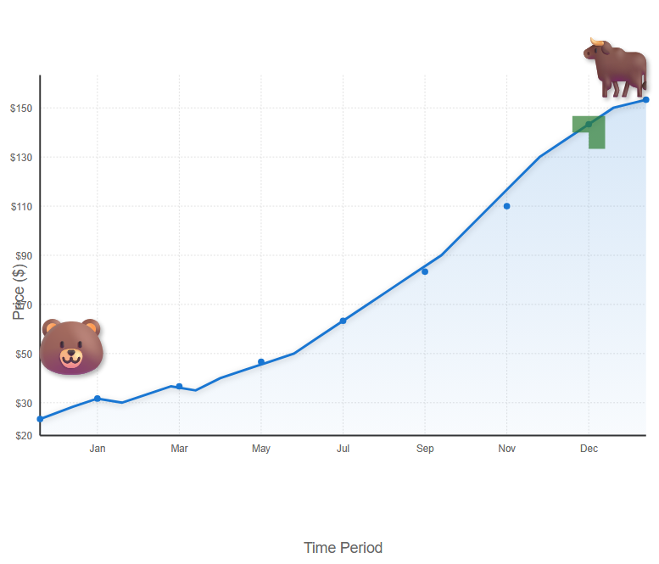
Why does uncertainty quantification matter?
Stock Investment Risk
https://deepai.org/machine-learning-model/text2img

Slide 7
Why does uncertainty quantification matter?
Uncertainty quantification is a crucial aspect of predictive modelling. Traditional predictions typically produce a single-point output for a given input because they rely on models that provide only the most likely outcome. These models either cannot capture the full complexity of the real world or are based on incomplete data.
Uncertainty can be broken into:
Aleatoric Uncertainty. This type of uncertainty arises from inherent randomness in the data. It is also known as statistical or irreducible uncertainty. In machine learning, aleatoric uncertainty can result from noise in the data or measurement errors.
Epistemic Uncertainty. This type of uncertainty arises from a lack of knowledge or information. It is also known as systematic or reducible uncertainty. Epistemic uncertainty can be reduced by gathering more data or improving the model.

Slide 8
Why Conformal Prediction ?
Uncertainty Quantification
Conformal Prediction
Certainty Quantification
Conformal prediction is a powerful machine learning framework used to evaluate the uncertainty of predictions. It turns point predictions into prediction sets/intervals.
Some advantages of using conformal prediction for uncertainty quantification:
-distribution-free;
-guaranteed coverage;
-model-agnostic;
-easy implementation

Slide 9
Conformal Prediction Properties
Validity
ensures that predictions are reliable and meet predefined coverage levels, making it crucial for applications where trust in predictions is relevant.
Efficiency
Exchangeability
ensures that predictions are consistent regardless of data order. For time series data, some mitigation approaches are required.
focuses on producing accurate and concise predictions, which is vital for practical implementation and resource management.

Slide 10
Full Conformal Prediction (Trasductive) leverages the entire dataset for training and requires model retraining for each new prediction. This approach ensures that each prediction is made with the most up-to-date information. It‘s the most general and computationally intensive approach.
Split Conformal Prediction
(Inductive) splits the data into training and calibration sets. The model is trained once on the training set, and the calibration set is used to adjust the prediction intervals. It‘s the computationally efficient variant.
Cross-Conformal prediction
is a resampling-based method that generalises the split conformal prediction. Data is split into K folds; for each fold, the model is trained on the remaining K-1 folds, and the prediction interval is computed on the left-out fold. The final prediction interval is built by aggregating results across all partitions.
Conformal Prediction Methods

Slide 11
Conformal Prediction as a Recipe
Non Conformity Score
Miscoverage rate/Coverage
Data Splitting (optional but common)
Train the model
Calibrate the model
Prediction on unseen data
https://medium.com/data-science/all-you-need-is-conformal-prediction-726f18920241

Slide 12

Conformal Prediction as a Recipe: numerical example on Time Series
🎯 First Goal
Build a 90% prediction interval for time series forecasting using conformal prediction.
✅ Assumptions
-15 consecutive timestamps of data.
-Predict the next value in the series using some forecasting model.
Split dataset:
-First 10 timestamps as the training set
-Next 5 timestamps as the calibration set
The conformal prediction goal is 90% coverage, so alpha = 0,1.
✅ Split Time Series
Time 1 2 3 4 5 6 7 8 9 10 11 12 13 14 15
Value 80 82 83 92 94 85 88 94 98 96 99 91 96 90 89
Train a model on timestamps 1–10
Predict timestamps 11–15 using the model trained on 1-10
Compute non-conformity scores for 11-15 (calibration) -> s= | $y −\hat{y}$|
Use those scores to form intervals for the future timestamp (16)

Slide 13

Conformal Prediction as a Recipe: numerical example on Time Series
✅ Train the Forecasting Model and get errors:
Time 11 12 13 14 15
True outcome 99 91 96 90 89
Predicted outcome 97 95 94 91 90
Non-conformity scores 2 4 2 1 1
✅ Sort the non-conformity scores (in ascending order): [1,1,2,2,4]
✅ Compute the quantile index (with finite sample correction) for the n samples
$k=min⁡(n,\left[\left(1−α\right)\left(n+1\right))\right]=\left[0,9×6\right]=\left[5,4\right]=5$
Set the threshold value from the sorted non-conformity scores => $\hat{q}$=5kth=4
✅ Build the prediction Interval
Given a prediction at the 16 timestamps $\hat{y}$=92
The 90% conformal prediction interval is: [$\hat{y}$- $\hat{q}$, $\hat{y}$+ $\hat{q}$]=[92-4,92+4]=[88,96]

Slide 14

Conformal Prediction as a Recipe: numerical example on Time Series
🎯 Second Goal
Build a 90% prediction interval for timestamp 17 using a rolling window approach. This preserves temporal order and allows the non-conformity scores to reflect the most recent data distribution, partially mitigating the non-exchangeability issue that violates standard conformal prediction assumptions.
✅ Split Time Series
Time 2 3 4 5 6 7 8 9 10 11 12 13 14 15 16
Value 82 83 92 94 85 88 94 98 96 99 91 96 90 89 90
Train a model on timestamps 2–11
Predict timestamps 12–16 using the model trained on 2-11
Compute non-conformity scores for 12-16 (calibration) -> s= | $y −\hat{y}$|
Use those scores to form intervals for the future timestamp (17)

Slide 15

Conformal Prediction as a Recipe: numerical example on Time Series
✅ Train the Forecasting Model and get errors
Time 12 13 14 15 16
True outcome 91 96 90 89 90
Predicted outcome 95 94 91 90 92
Non-conformity scores 4 2 1 1 2
✅ Sort the non-conformity scores (in ascending order): [1,1,2,2,4]
✅ Compute the quantile index (with finite sample correction) for the n samples
$k=min⁡(n,\left[\left(1−α\right)\left(n+1\right))\right]=\left[0,9×6\right]=\left[5,4\right]=5$
Set the threshold value from the sorted non-conformity scores => $\hat{q}$=5kth=4
✅ Build the prediction Interval
Given a prediction at the 17 timestamps $\hat{y}$=93
The 90% conformal prediction interval is: [$\hat{y}$- $\hat{q}$, $\hat{y}$+ $\hat{q}$]=[93-4,93+4]=[89,97]

Slide 16
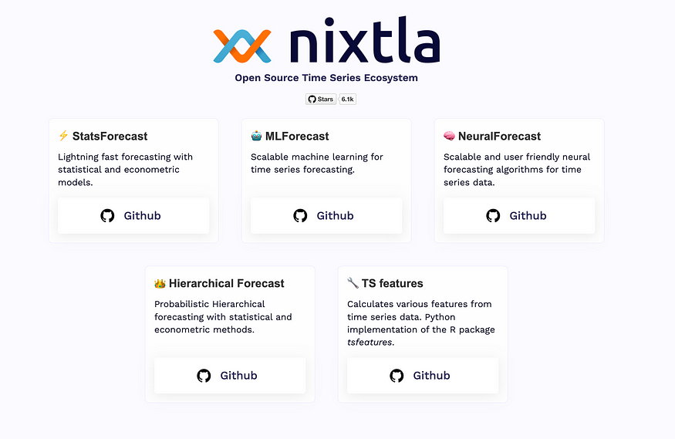
Conformal Prediction with NIXTLA
Nixtla is an open-source framework dedicated to time series forecasting, and it is helpful for low-code.
Organized into the following libraries:
-StatsForecast;
-MLForecast;
-NeuralForecast;
-TimeGPT
Conformal Prediction Approaches:
-Conformal Distribution;
-Conformal Error
Nixtla’s Approach to Non-Exchangeable Data using Rolling Window Cross-Validation for Interval Calibration
https://www.nixtla.io/open-source

Slide 17
What are AI Agents?
An AI agent is an application designed to achieve a goal by observing the world and acting upon it using the available tools. These agents are autonomous and can act independently of human intervention when given proper goals. In the context of Generative AI, an agent is a program that enables Large Language Models (LLMs) to perform actions by extending their capabilities through access to tools, knowledge, and learning from experience.
LLMs
Action
Knowledge
Tools
Learning

Slide 18
Reasoning
Collaborating
Why AI Agents?
-> Autonomously Perform Tasks
-> Adapt and Learn
-> Increase Productivity and Efficiency
-> Enable Personalisation and Scalability
Acting
Observing
Self-Refining
Planning

Slide 19

pyautogen framework for AI Agents development
AutoGen (pyautogen), now as AG2, is an open-source programming framework originally developed by Microsoft. It is designed for building AI agents and facilitating sophisticated cooperation among multiple agents to solve complex tasks.
https://deepai.org/machine-learning-model/text2img

Slide 20
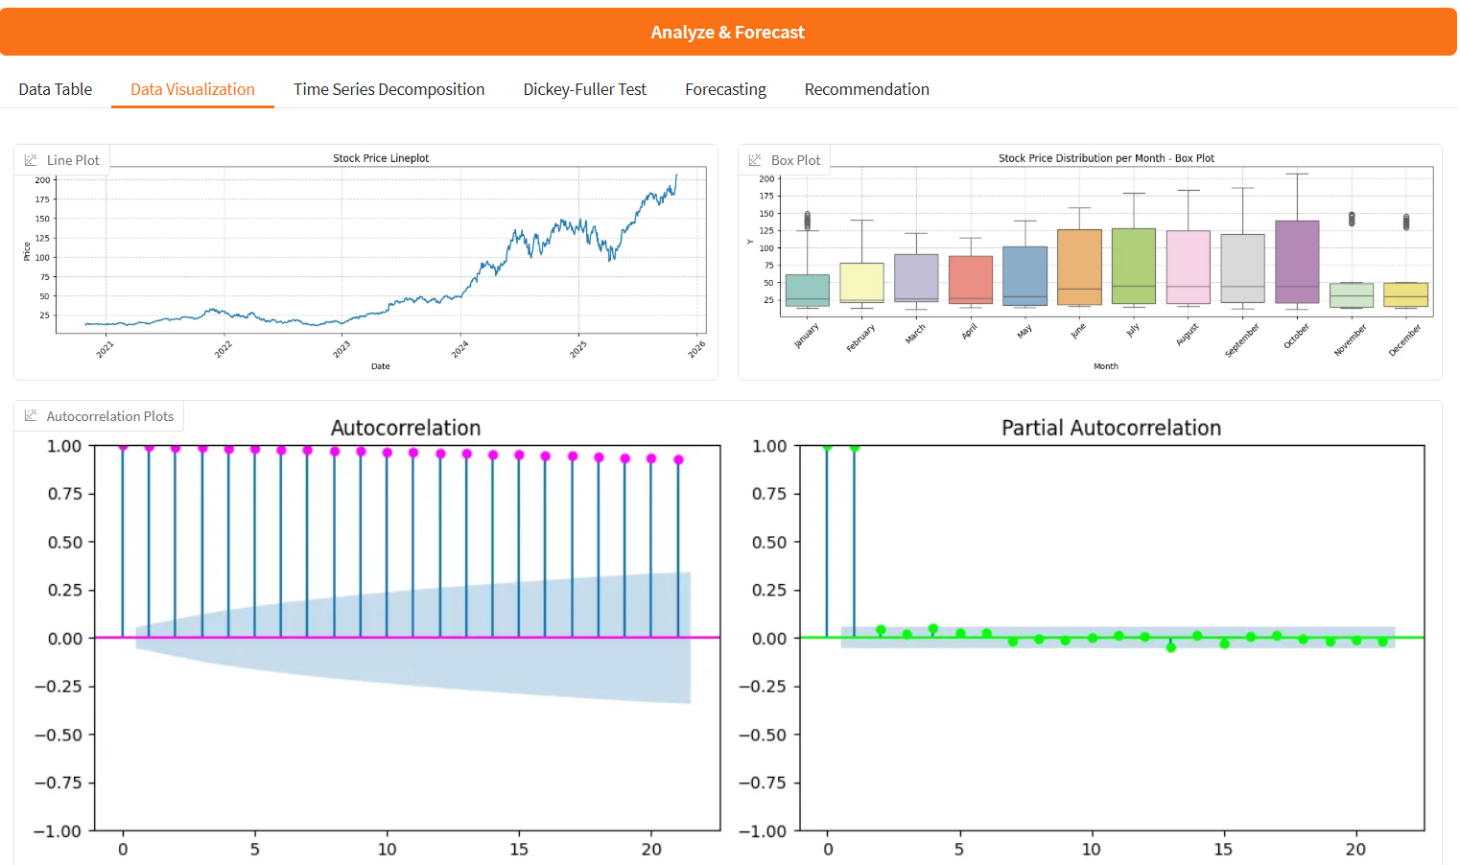

Build the App
Hugging Face app
Data Visualization and Statistical Analysis

Slide 21
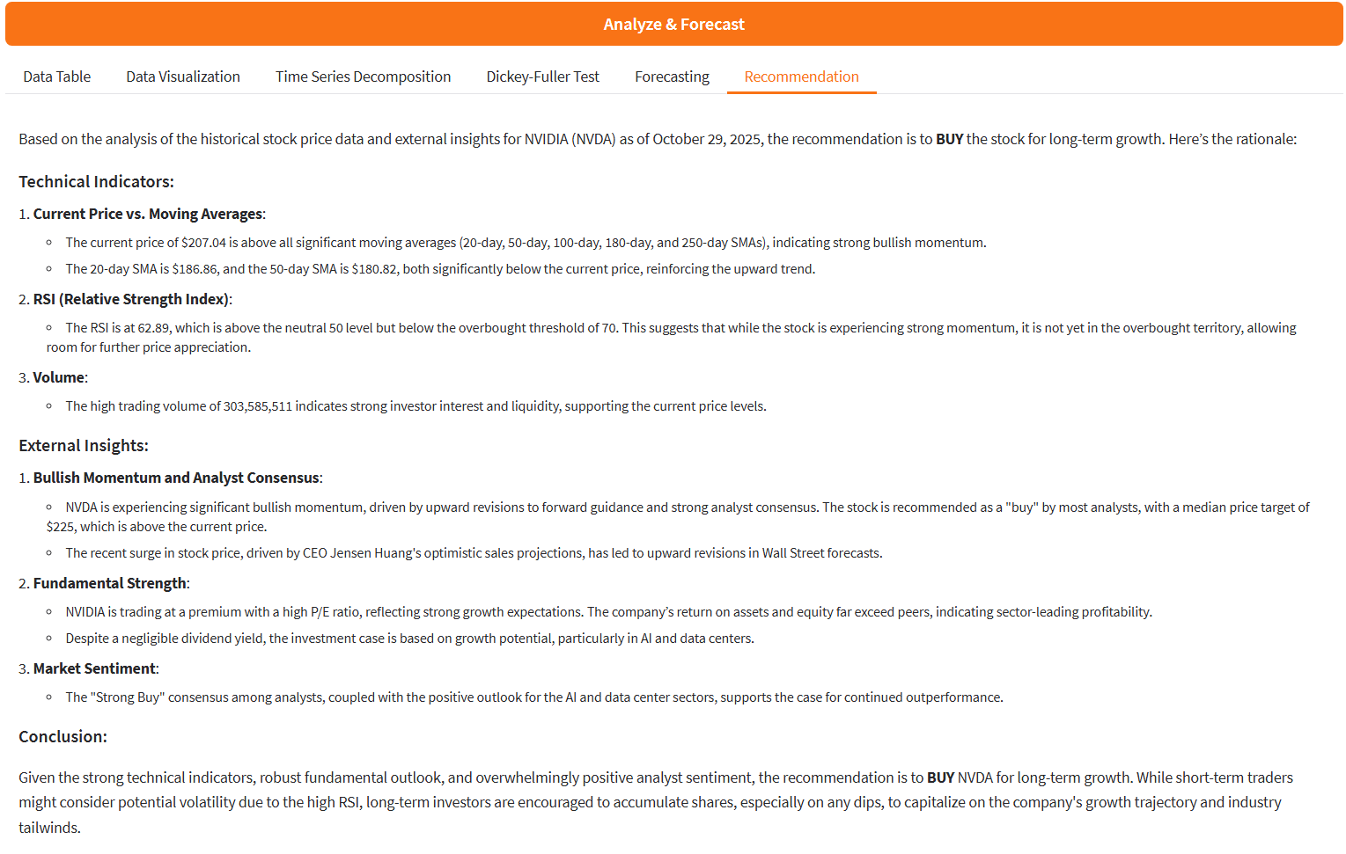
Build the App
Hugging Face app
A recommendations system by an Agent that orchestrates information coming from indexes calculated by the time series and data from web search.

Slide 22
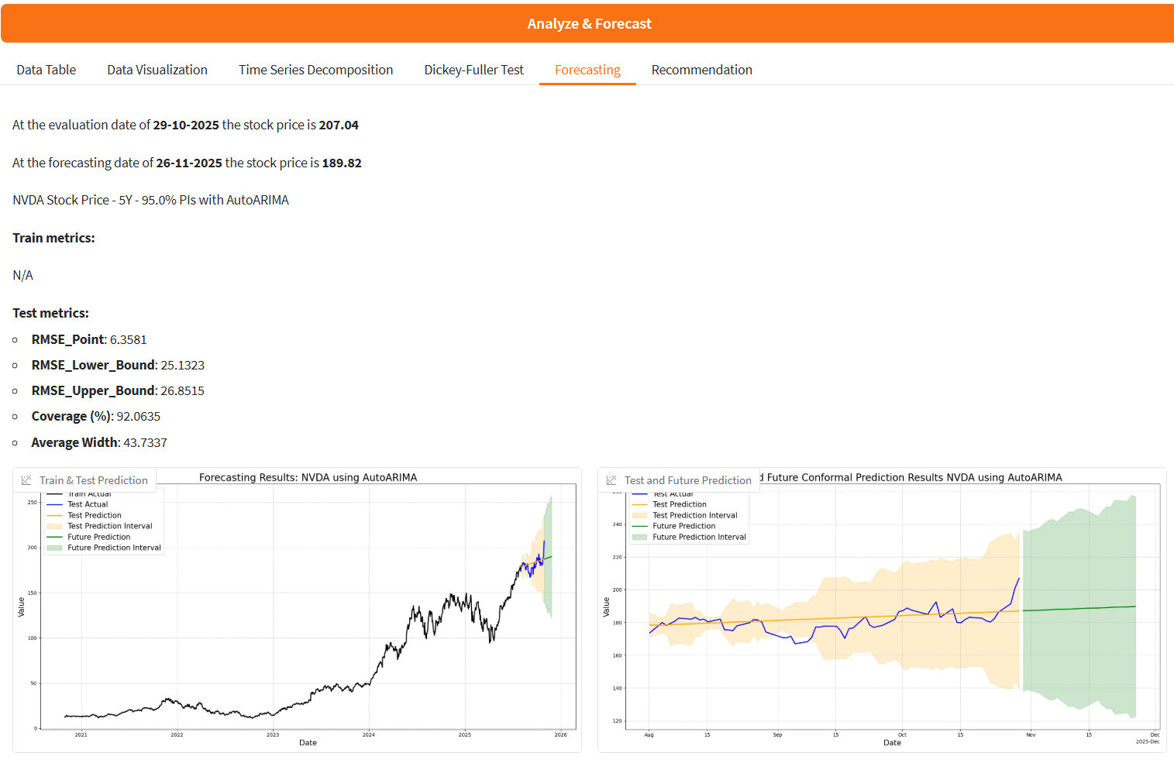
Build the App
Hugging Face app
Forecasting with AutoArima, AutoXGBoost, NHITS and TimeGPT

Slide 23
Conclusions
What I’ve learned
✅NIXTLA for time series is a good open-source framework projected for use cases with low code and the opportunity for scalable solutions.
✅AI Agents employed as recommendation systems are powerful in explaining your data and in managing external resources.
✅Hugging Face Spaces are GitHub repositories that are easy to use and can be used as your portfolio.

Slide 24
References
A Gentle Introduction to Conformal Prediction and Distribution-Free Uncertainty Quantification
Theoretical Foundations of Conformal Prediction
A Tutorial on Conformal Prediction
Conformal Prediction: A Unified Review of Theory and New Challenges
Conformal Prediction Guide
Practical Guide to applied Conformal Prediction in Python
Introduction to Conformal Prediction in Python
Awesome Conformal Prediction
Forecasting: Principles and Practice, the Pythonic Way
pyautogen · PyPI
Gradio Documentation
Introduction - TimeGPT Foundational model for time series forecasting and anomaly detection
StatsForecast ⚡️ - Nixtla
mlforecast – Nixtla
About NeuralForecast – Nixtla
Notebooks
stock-market-forecasting-with-nixtla-conformal-prediction

Slide 25

US Injuries Flood Prediction with Large Language Models Data Augmentation

Slide 26

Motivations: Earth’s Changing Climate is the new challenge of this century
https://www.climatechangeguide.com/climate-change.html

Slide 27

What is Climate Change?
Climate change refers to a significant difference in the average temperature, precipitation, wind patterns, cloudiness, humidity, atmospheric pressure, and other factors of the climate system observed over decades, usually 30 years or more.
https://www.wwf.org.uk/learn/climate-change

Slide 28
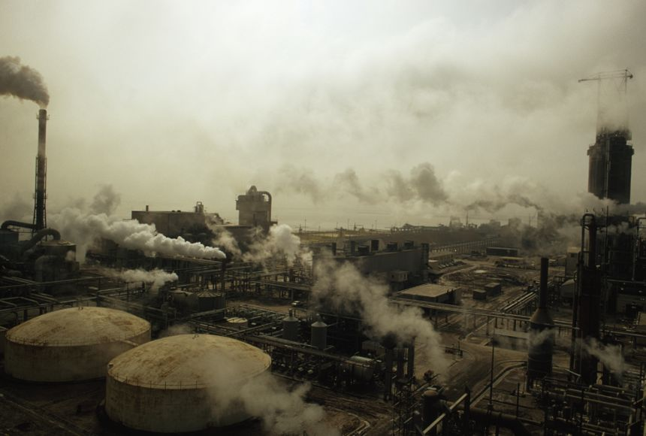
What causes Climate Change?
Burning fossil fuels: industrialised nations have been burning excessive amounts of fossil fuels like coal, oil, and gas for the past 150 years, which releases carbon dioxide.
Farming and livestock breeding: countries have intensified their agricultural activities to sustain meat-heavy diets, resulting in significant greenhouse gas emissions.
Cutting down forests: large-scale deforestation reduces the absorption of carbon dioxide, as trees naturally absorb it.
https://education.nationalgeographic.org/resource/earths-changing-climate/

Slide 29

The Impact of Climate Change
-Extreme weather events
-Ecological effects
-Impacts on people
-Damage and fatalities
https://www.wwf.org.uk/learn/climate-change#why-we-need-to-act-now-on-climate-change

Slide 30
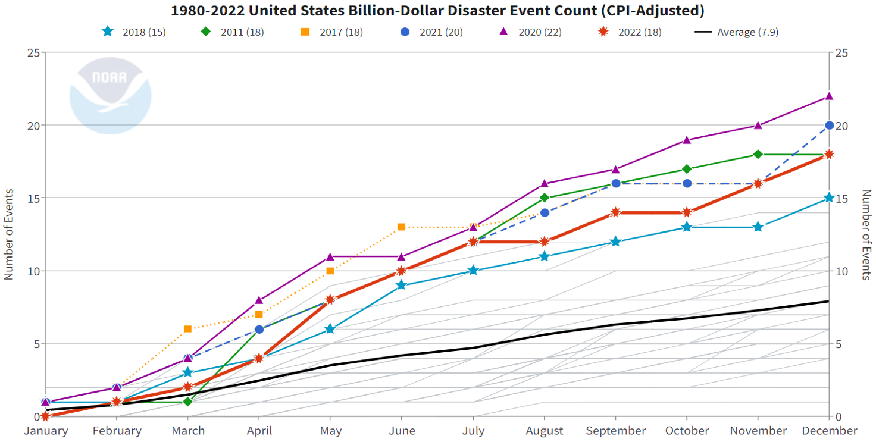
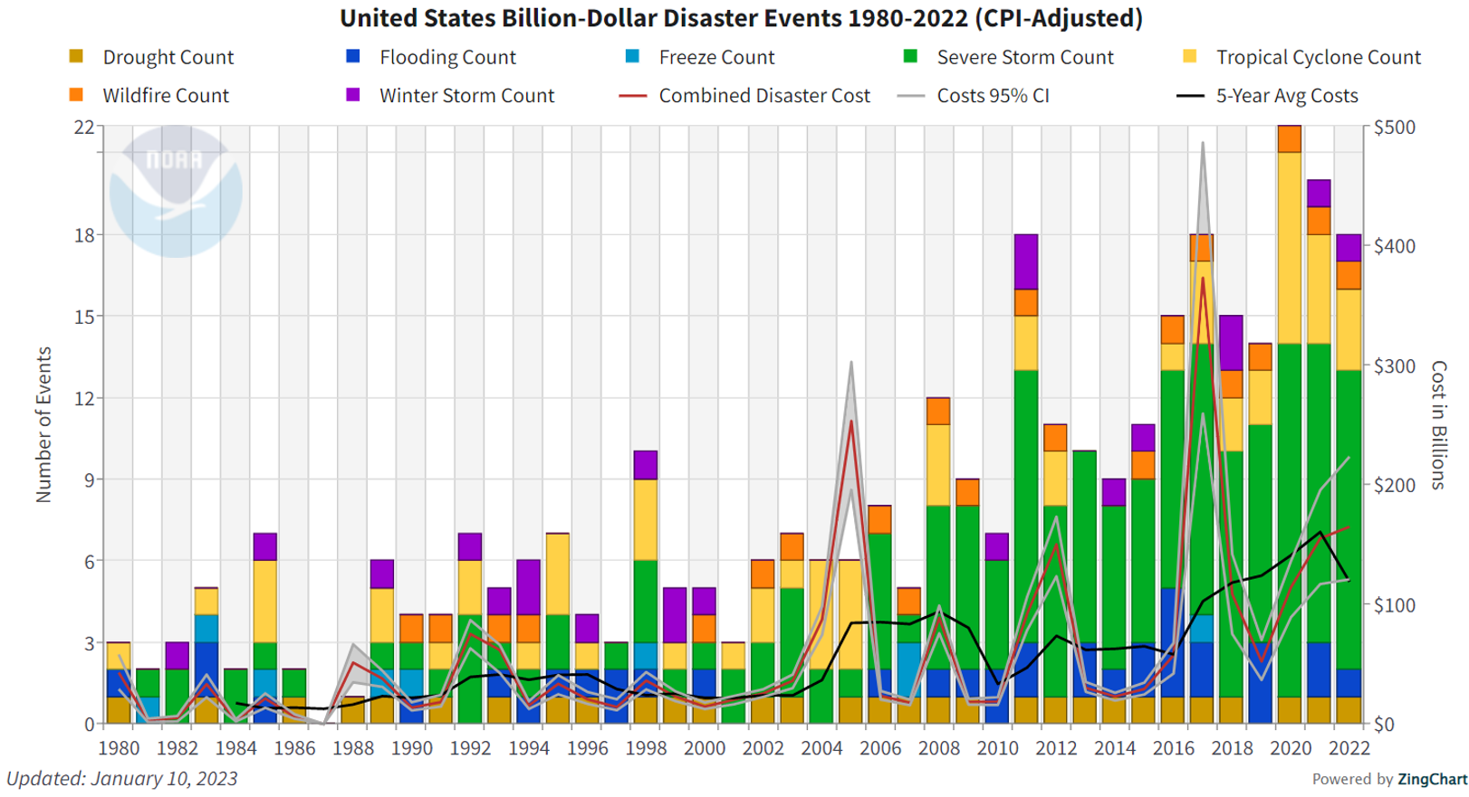

Influence of Climate Change on Environmental Events
In 2023, the NOAA National Centers for Environmental Information (NCEI) released the 2022 U.S. weather and climate disasters report. Since 1980, the U.S. has experienced 341 weather and climate disasters where overall damages/costs reached or exceeded $1 billion, with a cumulative cost exceeding $2.475 trillion. Mitigating future risks requires addressing the compounding hazards driven by our changing climate.
https://www.climate.gov/news-features/blogs/beyond-data/2022-us-billion-dollar-weather-and-climate-disasters-historical

Slide 31


Data Flow Chart
Data Cleaning
Data Augmentation with LLMs
Feature Engineering
Data Collection
ExploratoryData Analysis
Pre-Processing
Risk Modelling
Single-Step
Forecasting
Multi-Step
Forecasting

Slide 32
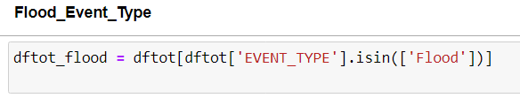
Data Collection & Data Cleaning
Data have been collected from the open source NCDC Storm Events Database.
Storm Data is provided by the National Weather Service (NWS) and contain statistics on personal injuries, deaths and damage estimates.
Storm Data covers the United States of America. The data collected began as early as 1950 through to the 2022.
The data contain a chronological listing, by state, of hurricanes, tornadoes, thunderstorms, hail, floods, drought conditions, lightning, high winds,
snow, temperature extremes and other weather phenomena.
From the website has been downloaded dataset for each year and then merged into one big dataset.
The data collected contains 51 columns included 2 text columns, and 1.794.914 rows.
The job has been done on “flood” event type, so firstly the database was realized selecting rows with the interested event type, then removing all missing values, and redundant columns or not related to the topic.
Last step involved the monetary conversion from string to numbers for the damage columns.
The final shape of the dataset: 31 columns x 38.398 records.
Database: https://www.ncei.noaa.gov/access/metadata/landing-page/bin/iso?id=gov.noaa.ncdc:C00510
Dictionary:
https://www.ncei.noaa.gov/pub/data/swdi/stormevents/csvfiles/Storm-Data-Bulk-csv-Format.pdf

Slide 33
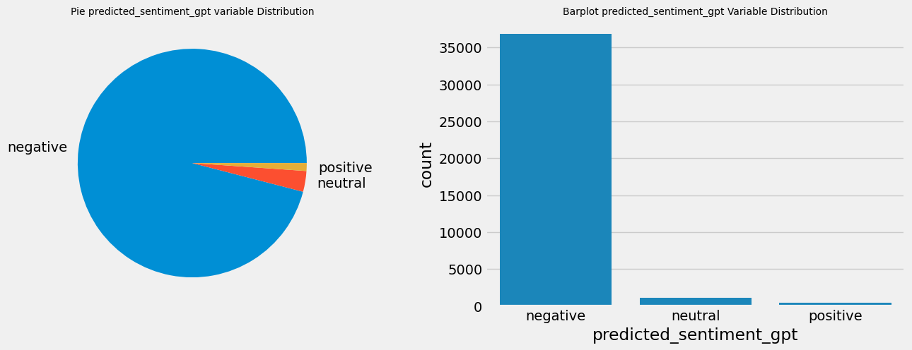
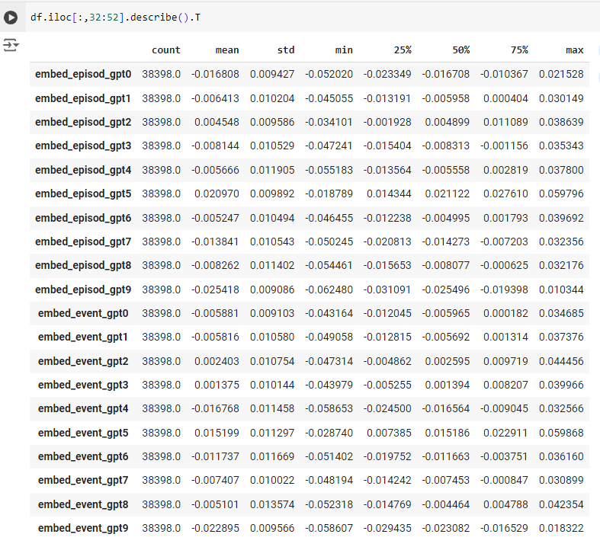
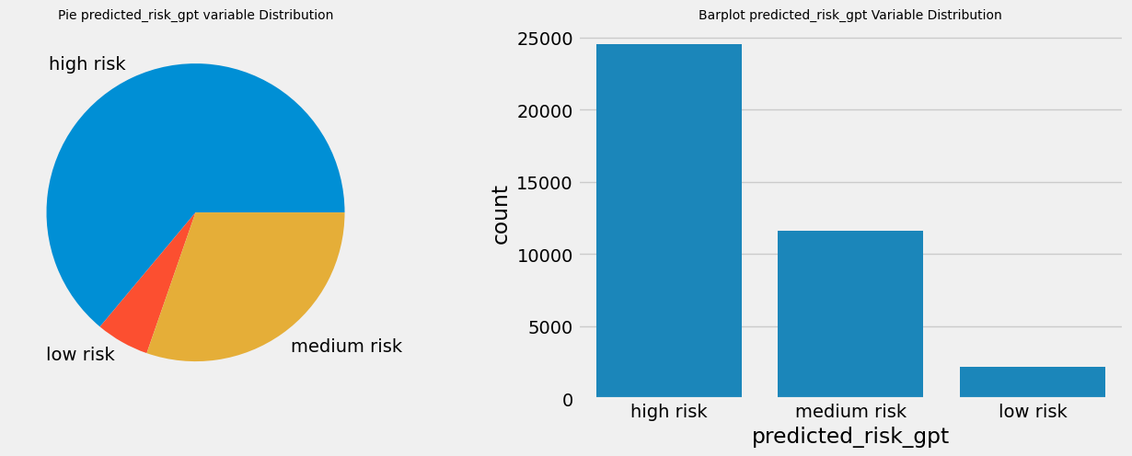
Data Augmentation with Large Language Models
Scikit-LLM is a Python library that incorporates large language models into the scikit-learn
framework. It’s a tool to perform Natural Language Processing (NLP) tasks all within the Scikit-Learn
pipeline. It started integrating OpenAI models. In this role, GPT-3.5 turbo (ChatGPT engine) was used for data augmentation by constructing features using zero-shot text classification and text vectorization.

Slide 34
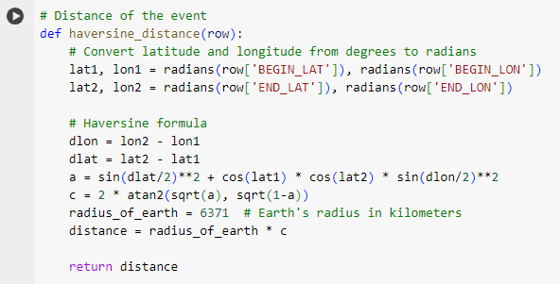
Feature Engineering
In this process, new features were created by extracting the year, month, day, and time from the beginning and end of each event. The difference between dates was extrapolated in days and hours, origin and destination names were merged, categorical features were encoded, grouping less relevant classes. New target variables were generated grouping the target variables of interest with secondary target variables. The distance between the starting and ending points of the event was calculated using the haversine distance. Lag and rolling window mean features were generated to capture seasonality.
Target Variables
Injuries Direct
Deaths Direct
Damage Property
Injuries Indirect
Deaths Indirect
Damage Crops
New Target Variables
Injuries Direct
Deaths Direct
Damage Property
Whole Injuries
Whole Deaths
Whole Damage

Slide 35
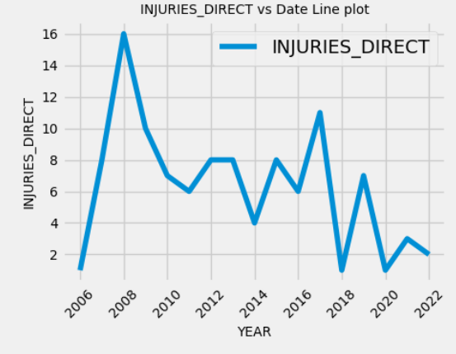
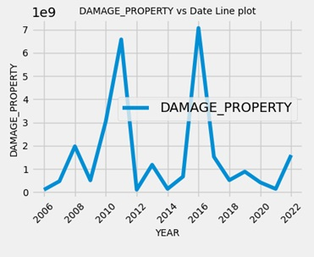
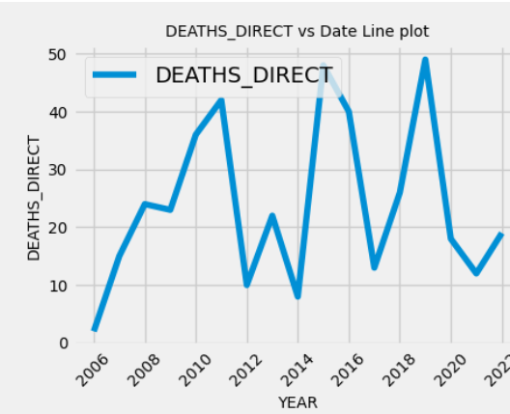
Exploratory Data Analysis
After data cleaning and data augmentation, the dataset reached the following shape:
53 columns and 38398 rows. The observations span from 2006 to 2022.
-The Injuries Direct target variable shows a peak of injuries in 2006, followed by a decreasing number in the subsequent years with a second peak in 2017. California had the highest number of injuries registered.
-The Deaths Direct target variable shows fluctuating behaviour, with peaks in mortality observed in 2011, 2015, and 2019. Kentucky, Missouri, and North Carolina had the highest number of deaths observed.
-The Damage Property target variable indicates two peaks of disasters in 2011 and 2016, with Lousiana having the highest level of damage.

Slide 36
Removed Outliers with Isolation Forest
Removed Zero Variance and Correlated Predictors
Pre-Processing

Slide 37
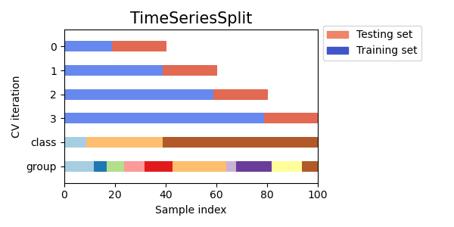
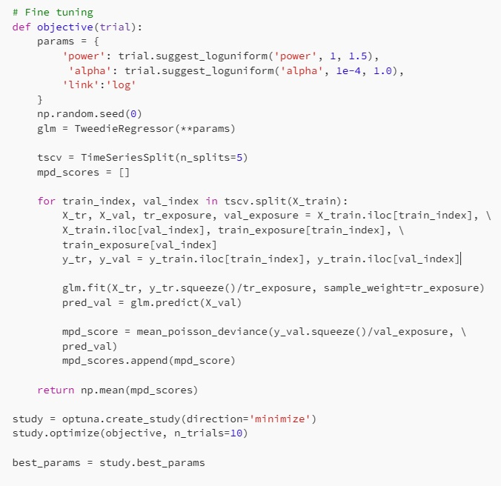
Risk Modelling
Generalized Linear Models (GLM) using Tweedie distribution
Generalized Additive Models (GAM)
Gradient Boosting Machines by LightGBM, XGBoost, CATBoost
Fine-tuned models using a time series cross validation with optuna, an automatic hyperparameter optimization software framework.

Slide 38
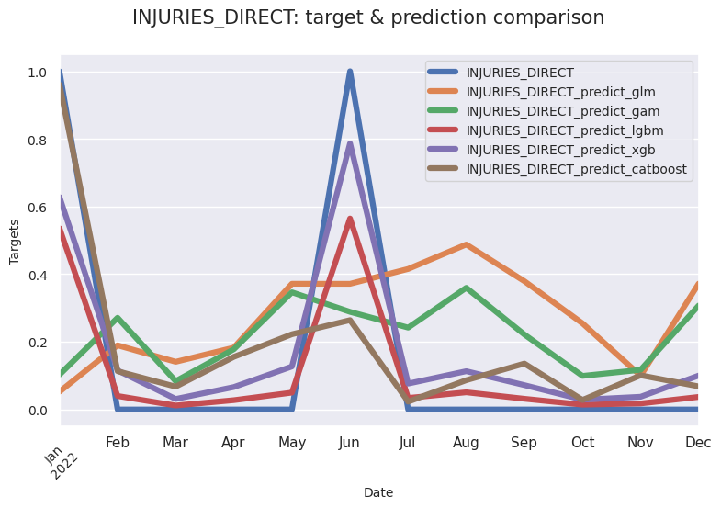
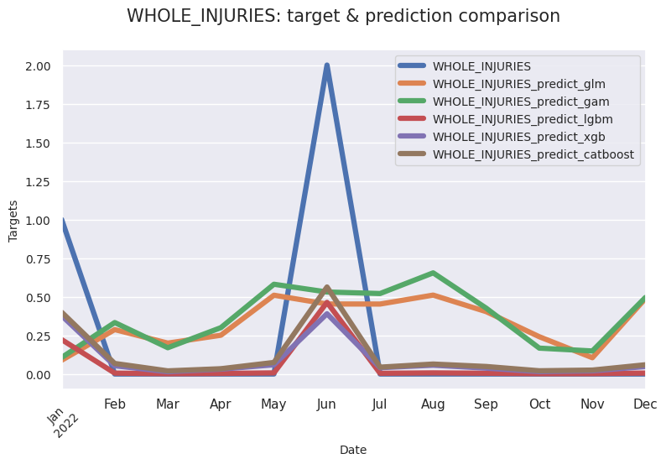
Single-Step Forecasting (Predictions)
Train:
2006-2021
Test:
2022
Gradient Boosting Machines can generalise observations in a better way

Slide 39
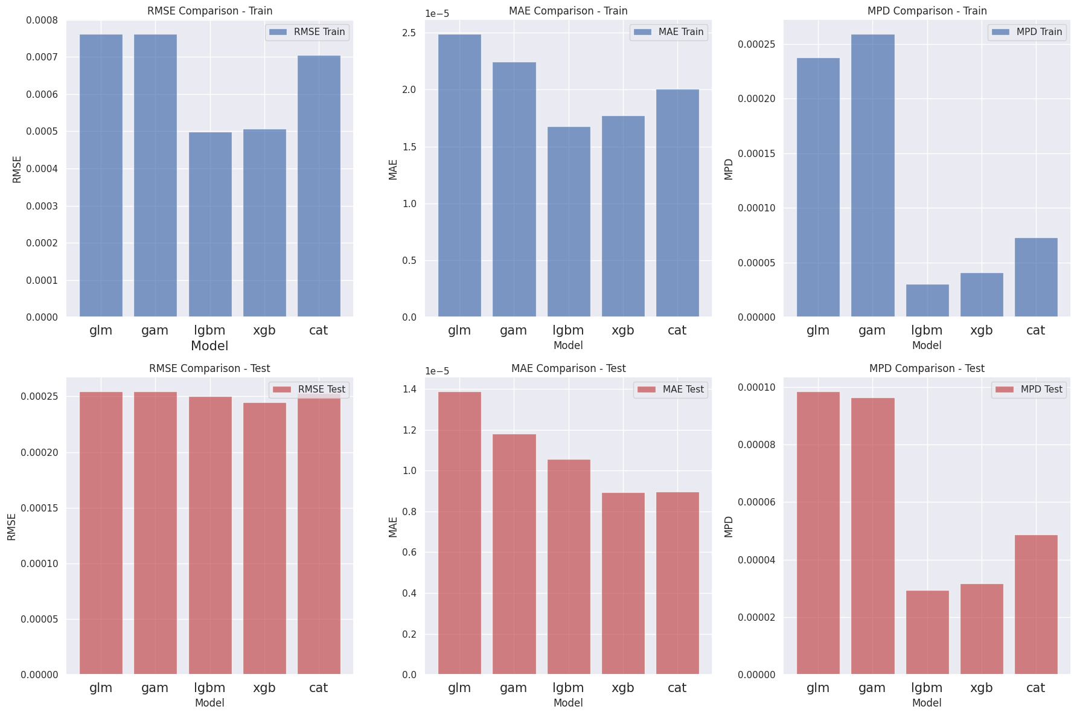
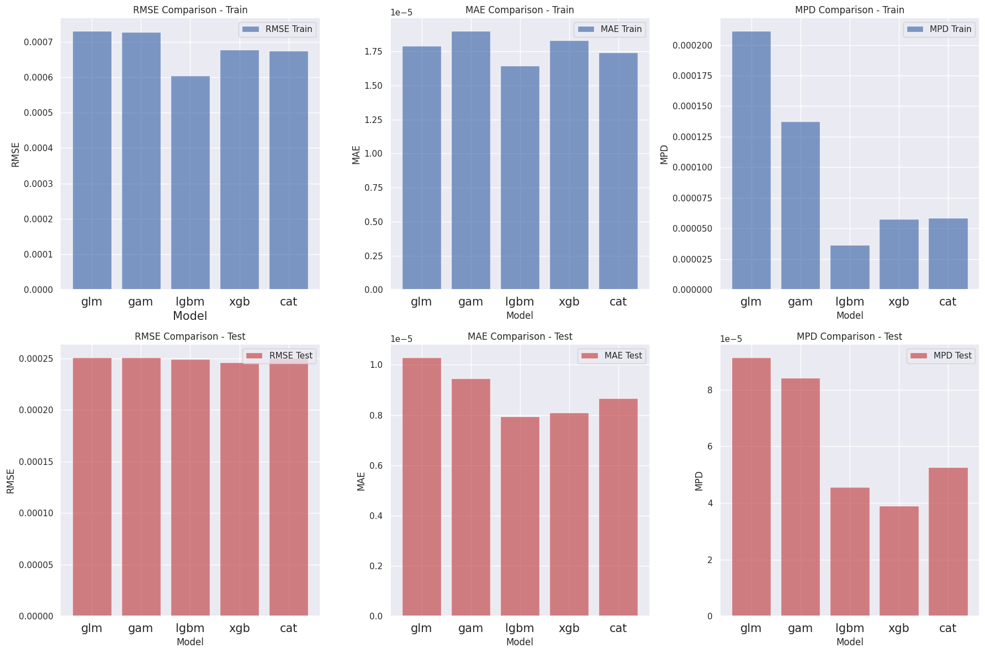
Single-Step Forecasting (Performance no augmentation)
Performance comparison on RMSE, MAE and Mean Poisson Deviance (MPD) metrics. Actuarial models are not competitive compared with Gradient Boosting Machines.
InjuriesDirect
Whole Injuries

Slide 40
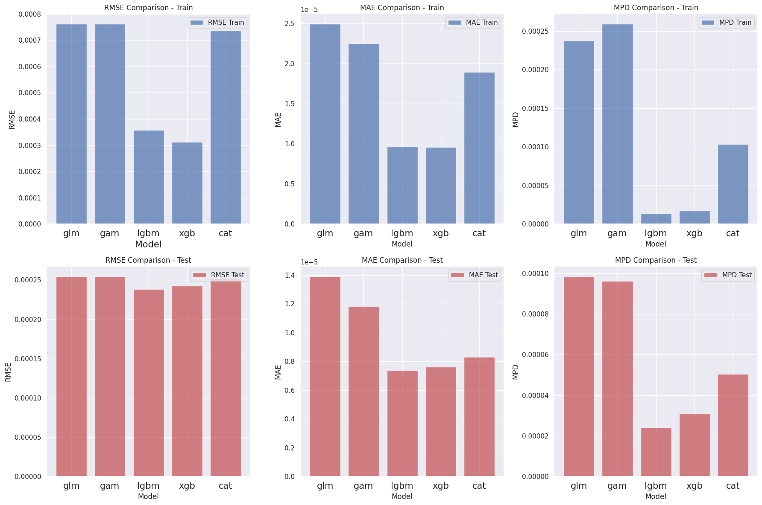
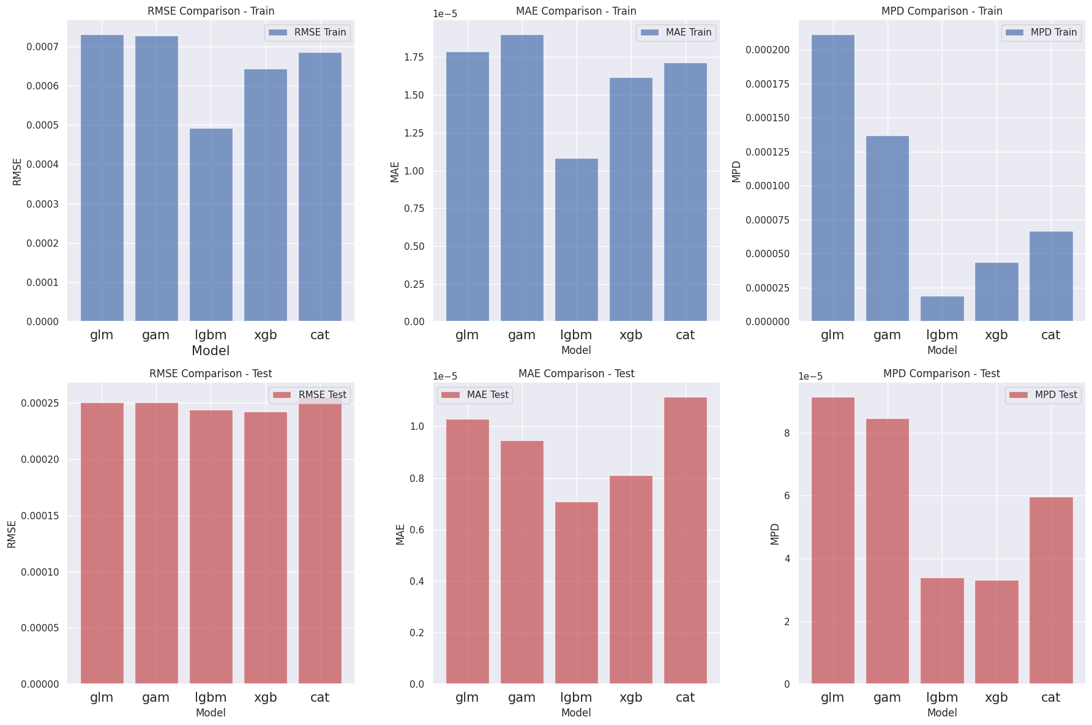
Single-Step Forecasting (Performance with augmentation)
Additional LLMs features boost performance at the ensemble trees, especially LightGBM and XGBoost.
Injuries Direct
Whole Injuries

Slide 41
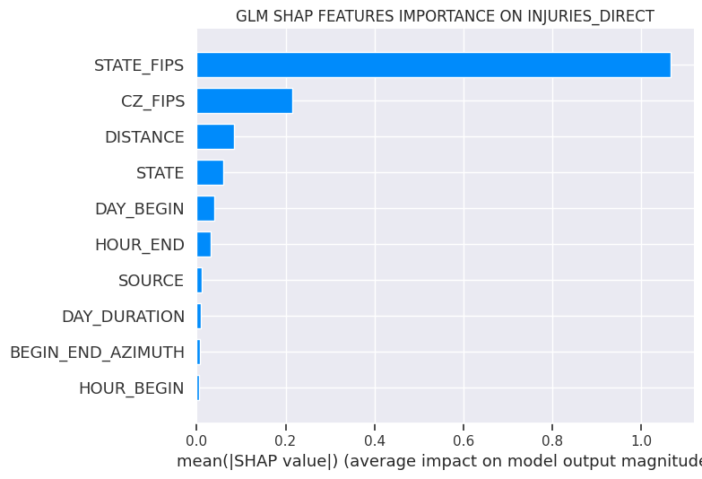
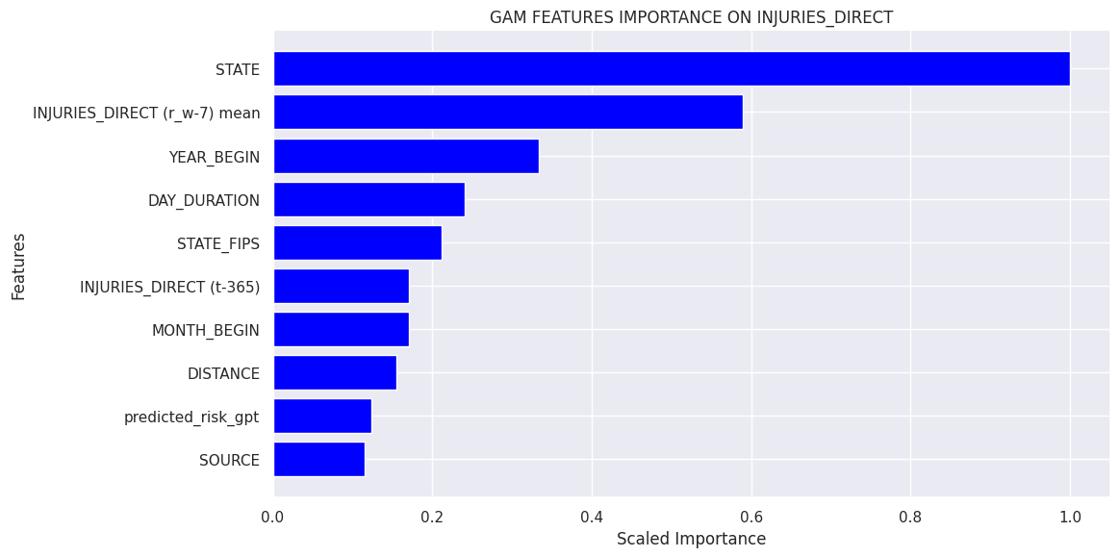
Single-Step Forecasting (Features Importance)
Only GAM shows the Predicted risk GPT feature among the top ten most important features,
but it does not impact on performance.

Slide 42
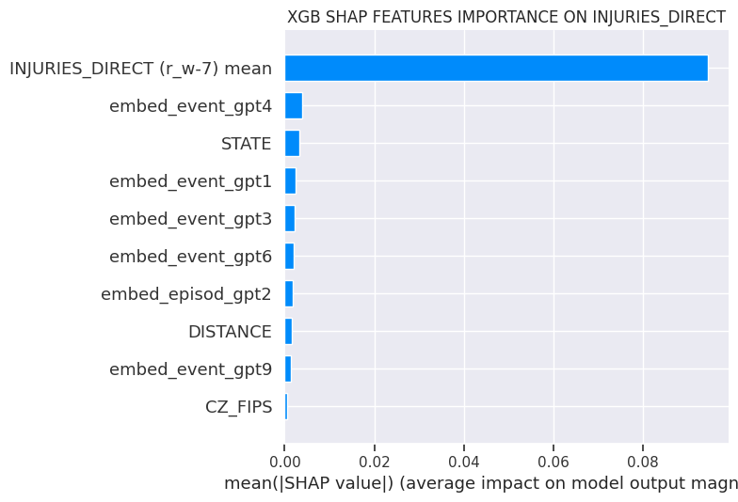
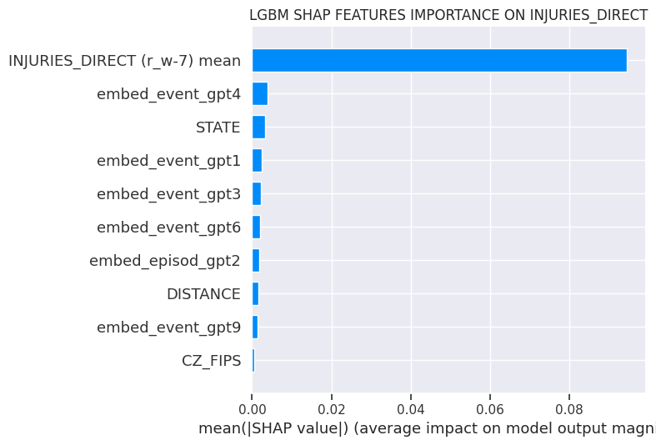

Single-Step Forecasting (Features Importance)
Gradient Boosting Machines shows rolling window mean as the most important feature followed by the embedding features.

Slide 43
Multi-Step Forecasting
In single step forecasting, the goal is to predict just the next time point: t -> t+1
In multi-step forecasting the goal is to predict the next horizon time points into the future, with h>1 and predict t+1, t+2, t+3…
One technique is the Recursive Forecasting: train one model and use it recursively for each step of the horizon.
Train:
2006-2019
T+1:
2020
T+2:
2021
T+3:
2022

Slide 44
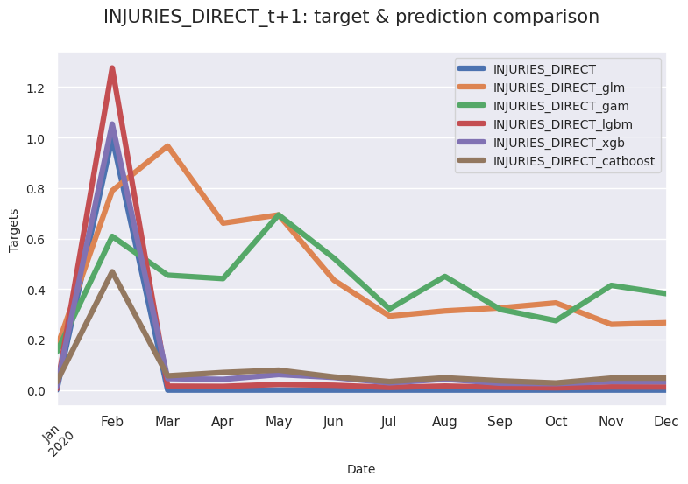
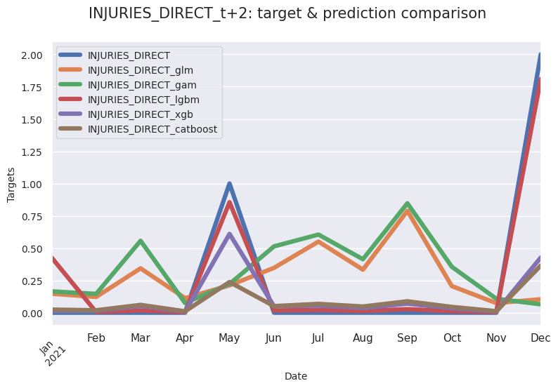
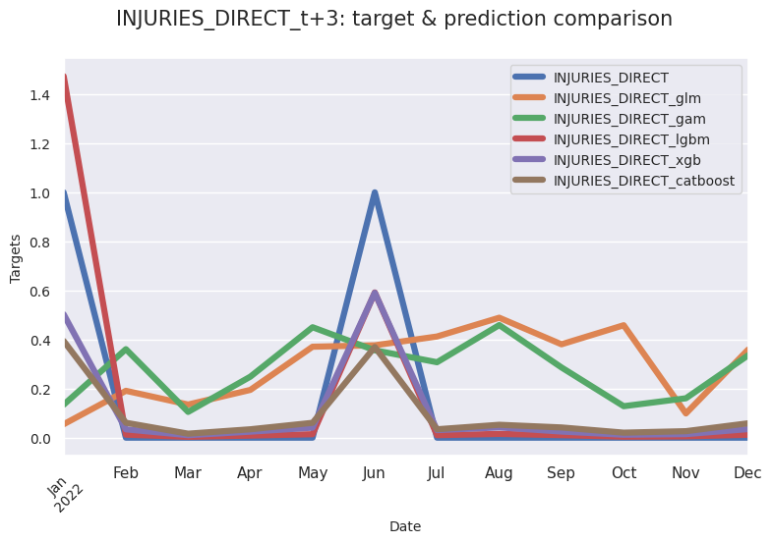
Multi-Step Forecasting (Predictions)
T+1
T+2
T+3
Gradient Boosting Machines outperform actuarial models in all forecasting steps.

Slide 45
Take-Aways
Fighting climate risk events requires big data to improve prediction and understanding features involved in these events.
This study showcases the potential of integrating modern Machine Learning and Generative AI to enhance climate change modelling and prediction. The results highlight the importance of feature engineering in general and the role of features extracted and generated by LLMs.
Modern Machine Learning and Generative AI can be used to improve the mapping of high-risk zones providing more accurate quotes.

Slide 46
References
Claudio G. Giancaterino, *US Injuries Flood Prediction with Large Language Models Data Augmentation*, SSRN. https://papers.ssrn.com/sol3/papers.cfm?abstract_id=5120965
P.J. Brockwell, R.A. Davis (2016). *Introduction to Time Series and Forecasting*, Springer.
J. Birkmann, T. Welle (2015). *Assessing the risk of loss and damage: exposure, vulnerability and risk to climate-related hazards for different country classifications*, International Journal of Global Warming.
Dineva Snezhana, (2023). *Applying Artificial Intelligence (AI) for Mitigation Climate Change Consequences of the Natural Disasters*, SSRN.
Adam B. Smith (2022). *2022 U.S. billion-dollar weather and climate disasters in historical context*, NOAA National Centers for Environmental Information.
Data: https://www.ncei.noaa.gov/access/metadata/landing-page/bin/iso?id=gov.noaa.ncdc:C00510
Github Repository: https://github.com/claudio1975/US_Injuries_Flood_Prediction

Slide 47

Sequence Sentiment Classification with Large Language Models

Slide 48

Motivations
Understanding how people feel at scale
Business intelligence & product decisions
Customer support triage
Social media monitoring
Better downstream tasks
Research & understanding human language

Slide 49

Natural Language Processing
The field of AI, which focuses on enabling machines to understand and interact with human languages through computational methods and algorithms.
NLP encompasses both understanding (NLU) and generation (NLG) of natural language:
NLU aims to extract meaning from text;
NLG involves creating coherent text.
Generated by claude.ai

Slide 50
Large Language Models
Language Models can be defined as a probability distribution over sequences of words.
Given a vocabulary of words, a Language Model assigns a probability to each sequence of words, and the purpose is to predict the next word in the sequence. A simple example of a model can be found in the Markov process.
Since the introduction of Transformer by Google in 2017, followed by BERT in 2018 and GPT by OpenAI in 2018, we have been listening to Large Language Models (LLMs).
Large Language Models are a breakthrough in the NLP field, with models like BERT and GPT trained on a vast amount of text data, showing remarkable abilities in understanding context and generating human-like text.

Slide 51
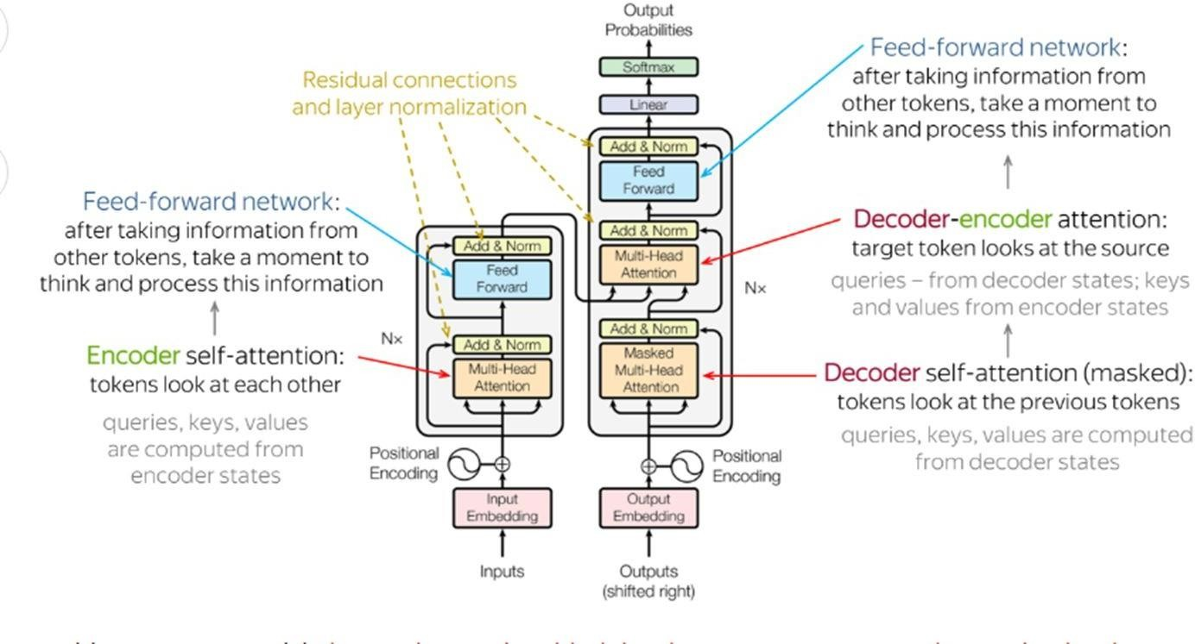
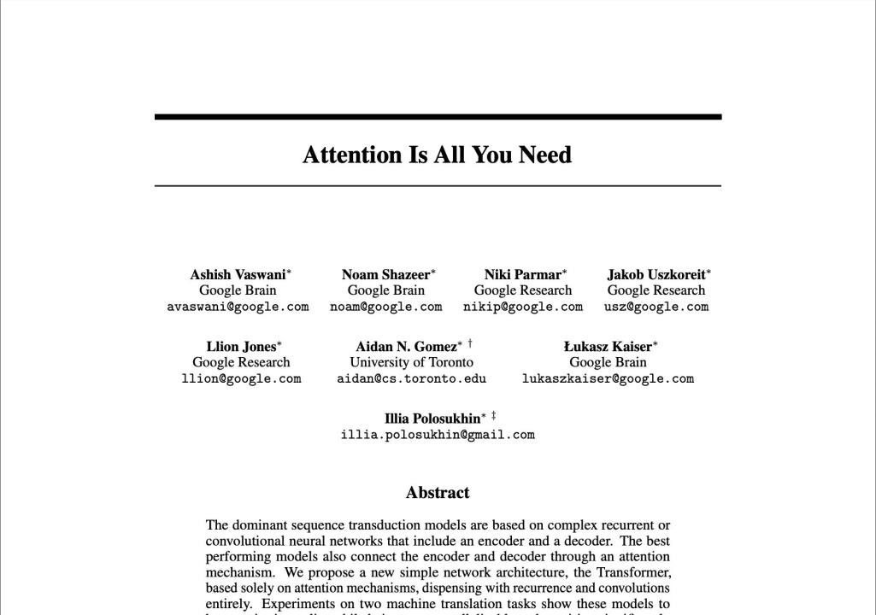
The Engine of Innovation: The Transformer
source
source

Slide 52
Unveiling How Large Language Models Process Text
Step 1: Convert words to number
Tokenization
(token ids)
Step 2: Convert token ids into vector
Token Embeddings
Step 3: Calculate the position of each token in the sequence of tokens
Step 4: Assign weights to every word relative to every other word
Step 5: Predicts the next word by assigning scores for every word
Positional Embeddings
Self-Attention
Feed-Forward Network
Step 6: Convert scores to probabilities
Softmax Layer
Step 7: Convert token ids into words
De-Tokenization

Slide 53
Unveiling How Large Language Models Process Text
Step 1: Convert words to numbers (Token IDS) -> Tokenization
Input text: I love machine learning
Token Dictionary:
“I”: 245
“love”: 1876
“machine”: 3421
“learning”: 2109

Slide 54
Unveiling How Large Language Models Process Text
Step 2: Convert token IDS into vector -> Token Embeddings
The Token Embeddings is a high-dimensional space where each token is mapped to a unique position called a vector.
machine
Vector Coordinates:
I
“I” (245):[0.3, 0.1, 0.8]
“love” (1876):[0.6, 0.7, 0.2]
“machine” (3421):[0.4, 0.5, 0.6]
“learning” (2109):[0.7, 0.3, 0.5]
love
learning

Slide 55
Unveiling How Large Language Models Process Text
Step 3: Calculate the position of each token in the sequence of tokens
-> Positional Embedding
Token Embedding and Positional Embedding are added to preserve the information about the token order.
Word | Token ID | Token Embedding | Positional Embedding | Final Input Embedding
I | 245 | [0.3,0.1,0.8] | [0.0,0.0,0.0] | [0.3,0.1,0.8]
love | 1876 | [0.6,0.7,0.2] | [0.1,0.1,0.1] | [0.7,0.8,0.3]
machine | 3421 | [0.4,0.5,0.6] | [0.2,0.2,0.2] | [0.6,0.7,0.8]
learning | 2109 | [0.7,0.3,0.5] | [0.3,0.3,0.3] | [1.0,0.6,0.8]

Slide 56

Unveiling How Large Language Models Process Text
Step 4:
Assign weights to every word relative to every other word -> Self-Attention
There are many self-attention layers. The intuition is that the self-attention head will learn a different aspect of language -> Multi-Head Self-Attention
I
love
machine
learning
I
love machine learning
I
love machine learning
I
love machine learning

Slide 57
Unveiling How Large Language Models Process Text
Step 5:
Predict the next word by assigning scores for every word ->Feed-Forward Network. The fully connected feed-forward network takes all of the attention weights as input and processes them. It predicts what it thinks the next word could be based on the training data. These predictions are not probabilities yet; they are scores or “logits”. All these scores form a “vector of logits”.
Step 6:
Convert scores to probabilities -> Softmax Layer
The word with the highest probability is chosen as the prediction.

Slide 58
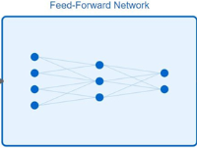
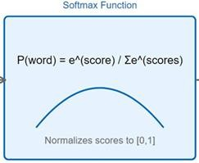
Unveiling How Large Language Models Process Text
First word generation:
Attention weights 245 [I]: 0.85
1876 [love] 0.12
3421 [machine] 0.02
2109 [learning] 0.01
Second word generation:
Attention weights 245 [I]: 0.15
1876 [love] 0.78
3421 [machine] 0.04
2109 [learning] 0.03
Third word generation:
Attention weights 245 [I]: 0.05
1876 [love] 0.10
3421 [machine] 0.72
2109 [learning] 0.13
Fourth word generation:
Attention weights 245 [I]: 0.03
1876 [love] 0.08
3421 [machine] 0.25
2109 [learning] 0.64
FFN output (logits) 4521 [Ich]: 9.2
3892 [Du]: 2.1
1847 [Wir]: 1.3
Softmax output -> Probabilities 4521 [Ich]: 87.3%
3892 [Du]: 8.2%
1847 [Wir]: 2.5%
Selected: 4521 [Ich]: 87.3%
FFN output (logits) 2834 [liebe]: 8.7
5621 [mag]: 5.2
3109 [habe]: 3.1
Softmax output -> Probabilities 2834 [liebe]: 76.4%
5621 [mag]: 18.3%
3109 [habe]: 5.3%
Selected: 2834 [liebe]: 76.4%
FFN output (logits)
7654 [maschinelles]: 9.1
2341 [Maschinen]: 6.8
8923 [Computer]: 4.2
Softmax output -> Probabilities 7654 [maschinelles]: 68.9%
2341 [Maschinen]: 24.7%
8923 [Computer]: 6.4%
Selected: 7654 [maschinelles]: 68.9%
FFN output (logits) 4123 [Lernen]: 9.5
6789 [Studieren]: 4.1
5432 [Training]: 3.3
Softmax output -> Probabilities 4123 [Lernen]: 82.1%
6789 [Studieren]: 11.2%
5432 [Training]: 6.7%
Selected: 4123 [Lernen]: 82.1%

Slide 59
Unveiling How Large Language Models Process Text
Step 7: Convert token IDS into words -> De-Tokenization
Token IDs 4521
2834
7654
4123
Decoded Text
Ich liebe maschinelles
Translation:
Input: "I love machine learning“
Output: "Ich liebe maschinelles Lernen"
Lernen

Slide 60

Transformer Taxonomy
Beyond text generation, Transformer architectures can be classified into encoder, decoder, and encoder-decoder types, each suitable for different tasks.
Encoder Transformers, like BERT, are used for tasks that require understanding the entire input sequence, such as sentence classification.
Decoder Transformers, like GPT, are used for text generation, predicting the next token in a sequence.
Encoder-decoder Transformers, like T5, are used for tasks involving both
encoding and decoding sequences, such as translation.

Slide 61

Strengths and Limitations of LMMs
Strengths:
Natural Language Understanding
Versatile Multimodal Generation
Automation and Efficiency
Limitations:
Contextual Understanding and Common Sense Reasoning
Bias and Ethical Concerns
Dependence on Data Quality
Computational Constraints
Complexity and Interpretability

Slide 62
Sentiment on Tweets
The Sentiment140 dataset contains 1.6 million tweets automatically labeled with sentiment using emoticons as noisy labels. Created by Stanford researchers in 2009, it includes positive tweets (labeled with :) or :D), negative tweets (labeled with :( or >:(), and a small portion of neutral tweets. Each entry contains the tweet text, sentiment label, date, username, tweet ID, and query term. https://www.kaggle.com/datasets/kazanova/sentiment140
Potential Use Cases:
Machine Learning Model Training & Benchmarking
Social Media Monitoring & Brand Management
Political Campaign & Election Analysis
Natural Language Processing Research
Customer Feedback Analysis
Market Research & Consumer Insights
Media & Content Analysis
Public Health & Crisis Communication
Financial Market Sentiment Analysis
Chatbot & Virtual Assistant Training

Slide 63
References
Attention is all you need
Transformer
Natural Language Processing with Transformers
A Primer on Large Language Models and Their Limitations
The Open-Source Advantage in Large Language Models (LLMs)
10 Biggest Limitations of Large Language Models
The Strengths and Limitations of Large Language Models
Assessing the Strengths and Weaknesses of Large Language Models
Github Repository: https://github.com/claudio1975/Medium-blog/tree/master/Sequence_Sentiment_Classification
https://www.kaggle.com/datasets/kazanova/sentiment140

Slide 64

Assignment

Slide 65

Hourly Energy Consumption
Hourly energy consumption data provides a detailed view of how electricity use changes throughout the day. Instead of relying on daily or monthly totals, hourly measurements reveal patterns tied to human activity, equipment cycles, weather conditions, and operational processes.
Many modern applications, such as demand forecasting, real-time grid balancing, energy-aware automation, and cost-optimization strategies, require understanding how energy use fluctuates at the hourly level. By doing so, organizations can design control systems, reduce operational costs, and support smarter, more resilient energy management across a wide range of use cases.
The hourly power consumption data is provided by the PJM Interconnection LLC (PJM) website and is expressed in megawatts (MW).

Slide 66
Data
4 time series are provided and retrieved from the Kaggle platform:
https://www.kaggle.com/datasets/robikscube/hourly-energy-consumption
Task
Choose one time series and develop a statistical analysis and forecasting on the Excel spreadsheet. Developing the same process for all time series to provide a global view is a plus. Write a short dissertation of 2-3 pages to link to the spreadsheet, explaining what you achieved, results, and learned.
Statistical Analysis
Build a stationarity analysis by summary statistics (mean, variance, standard deviation, coefficient of variation). Draft useful plots to understand patterns. Mandatory plots are: lineplot, time series decomposition in trend, seasonality, and errors, histogram, and autocorrelation plot.
Forecasting
Split the time series into train and test sets and make predictions with three benchmark approaches: classical naïve with 1-hour lag observation, seasonal naïve with 24-hour lag observations, and a 24-hour moving average. Evaluate the models with graphical line plots on train and test sets, plot residuals, and compare the metrics results of RMSE, MAE, and MAPE.

Slide 67
References
Data: https://github.com/claudio1975/Master_IA_Data_Management/tree/main
https://www.kaggle.com/datasets/kazanova/sentiment140
https://machinelearningmastery.com/time-series-forecasting-python-mini-course/
https://www.uniba.it/it/docenti/leogrande-domenico/attivita-didattica/7Lanalisidelleseriestoriche.pdf

